Slide 1



Sarvajanik College of Engineering and Technology
A Hardware Implementation using Verilog HDL
Heart Attack Risk
Detector
Using Perceptron Classifier

Slide 2


Group Members
Team 8-Bit Coders
Dhwanil Desai Enrollment No.:-ET24BTEC701
Karan Trivedi Enrollment No.:- ET24BTEC064
Dhyey Shah Enrollment No.:-ET24BTEC054
Krutarth Sonicha Enrollment No.:- ET25BTEC808

Slide 3

Problem Statement
Hardware Perceptron Challenge
Designed a hardware-based heart attack risk detection system using a perceptron classifier implemented in Verilog HDL.

Slide 4
About the Problem
Heart disease detection requires timely and accurate prediction, but most existing systems are software-based and not suitable for real-time, low-power hardware applications.
The problem is to design a simple, fast, and efficient hardware-based system using a perceptron classifier in Verilog HDL that can predict heart attack risk using multiple inputs with minimal resources and real-time performance.

Slide 5
Importance of Problem
• Helps in early detection of heart disease risk
• Enables timely medical attention and preventive care
• Reduces chances of severe health complications
• Provides fast and real-time risk prediction
• Makes healthcare more accessible through portable devices
• Works with low power and minimal hardware resources
• Useful for continuous monitoring in daily life
• Promotes awareness and healthier lifestyle choices

Slide 6
Applications
• Can be used in wearable devices to keep track of heart health in daily life
• Helpful for quick health check-ups at home or in small clinics
• Assists doctors by giving quick risk indications during initial diagnosis
• Can be added to fitness devices to monitor overall health and lifestyle
• Useful in rural or remote areas where advanced medical facilities are not easily available
• Allows real-time monitoring so users can stay aware of their health anytime
• Encourages people to take preventive actions and maintain a healthier lifestyle
ons

Slide 7
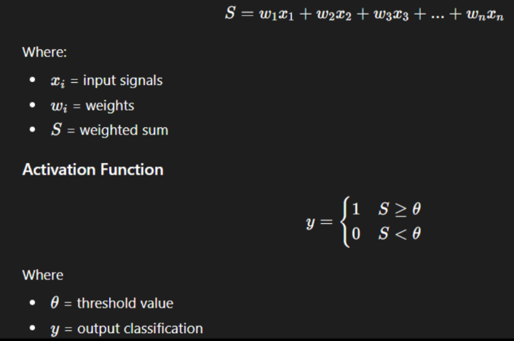
Mathematical Model

Slide 8
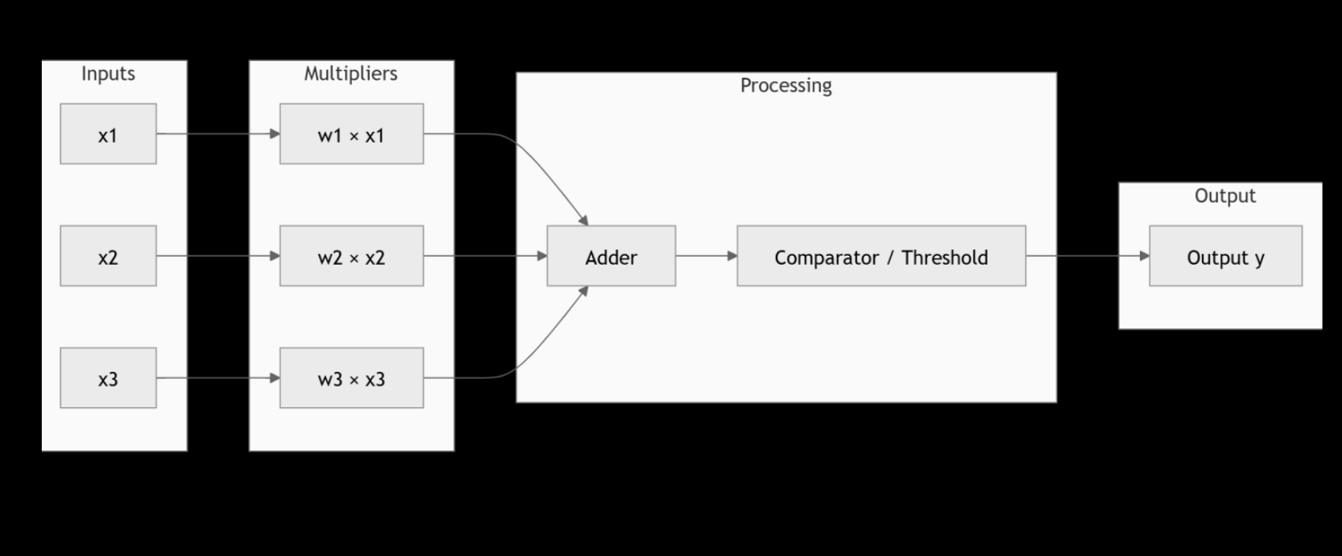
Block Diagram

Slide 9
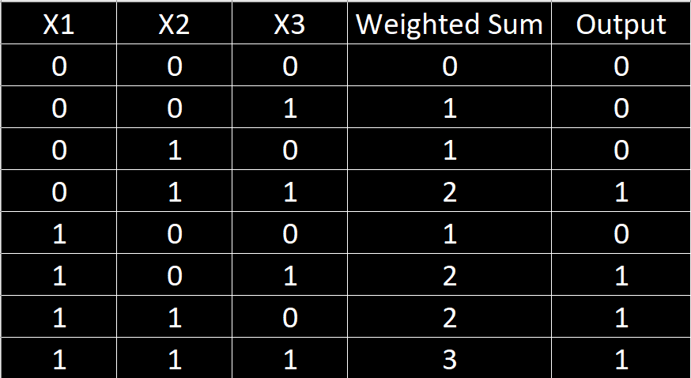
Truth Table
Assume
Weights = 1
Threshold = 2

Slide 10
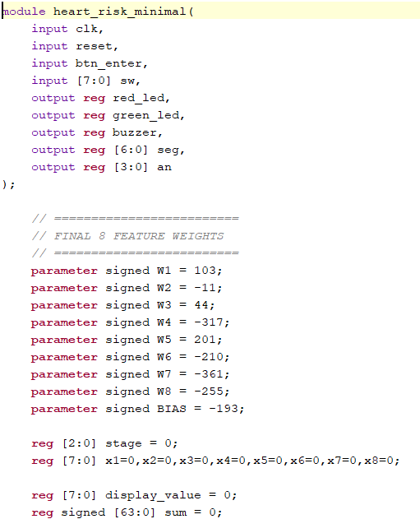
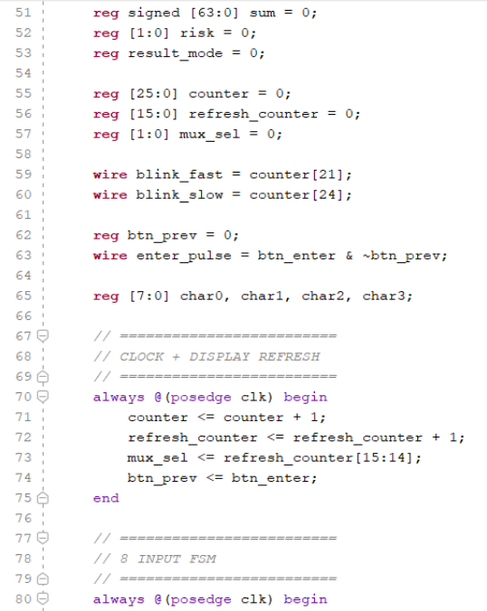
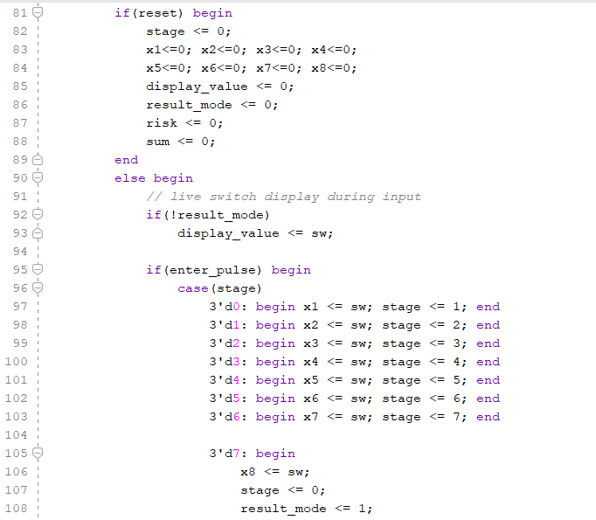
Verilog Code

Slide 11
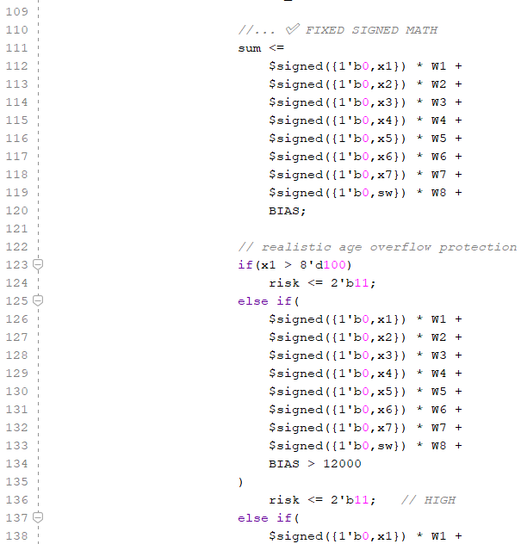
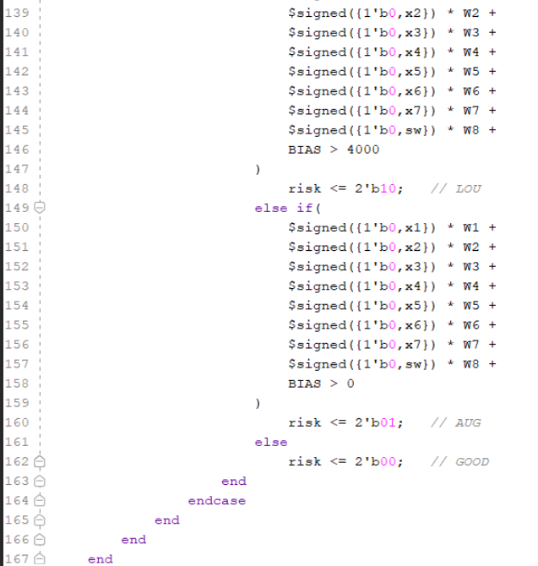
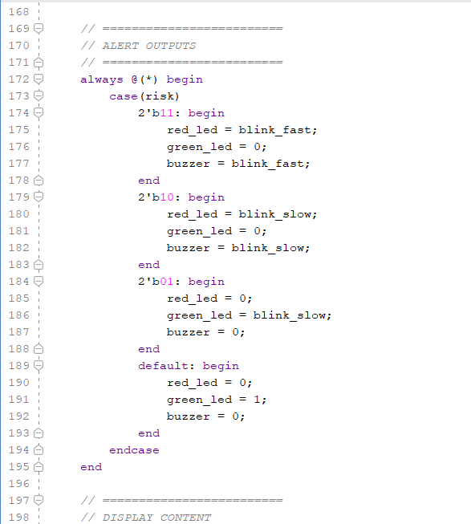
Verilog Code

Slide 12
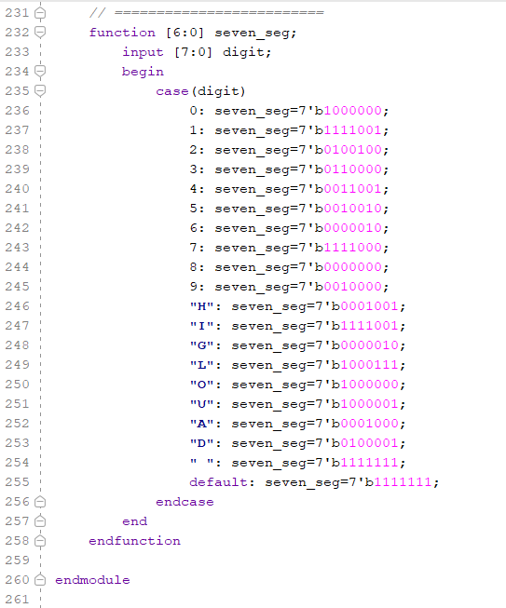
Verilog Code

Slide 13
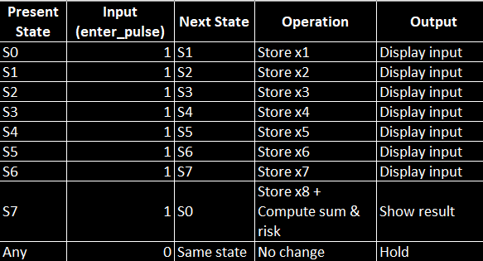
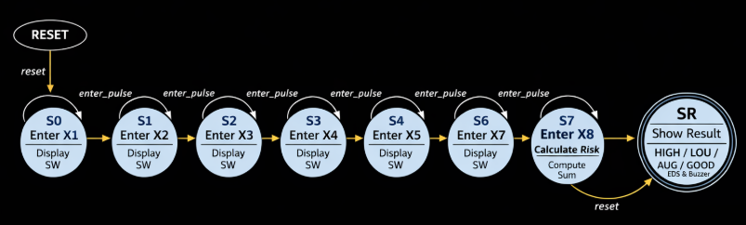
FSM

Slide 14
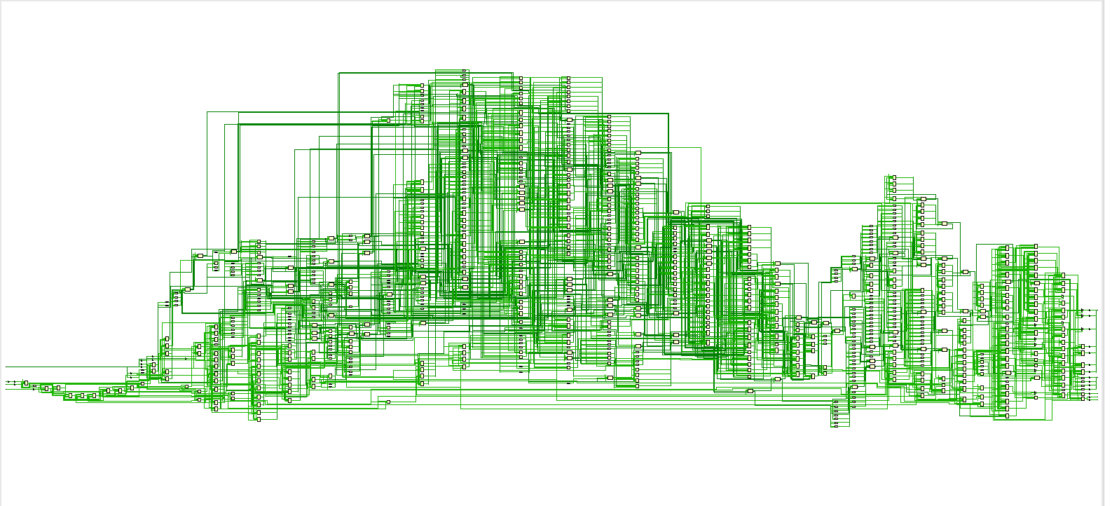
RTL Diagram

Slide 15
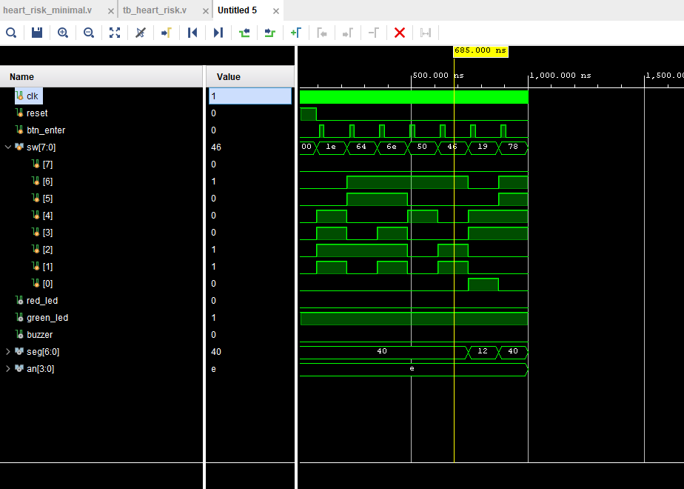
Output Waveform

Slide 16
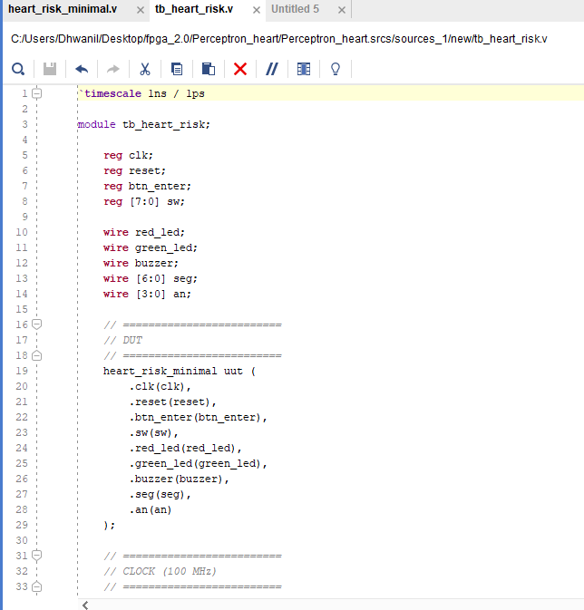
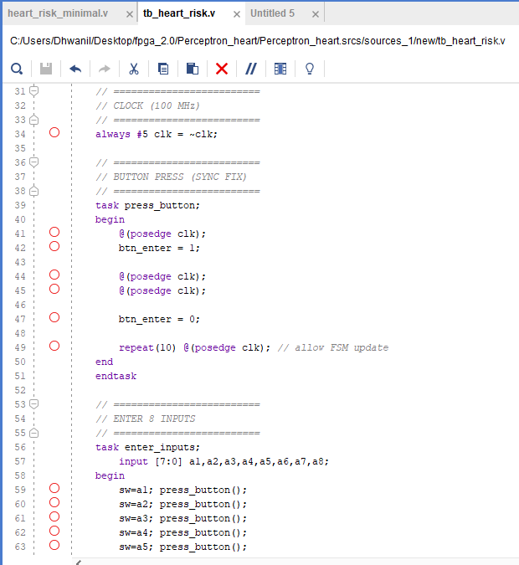
Test Bench code

Slide 17
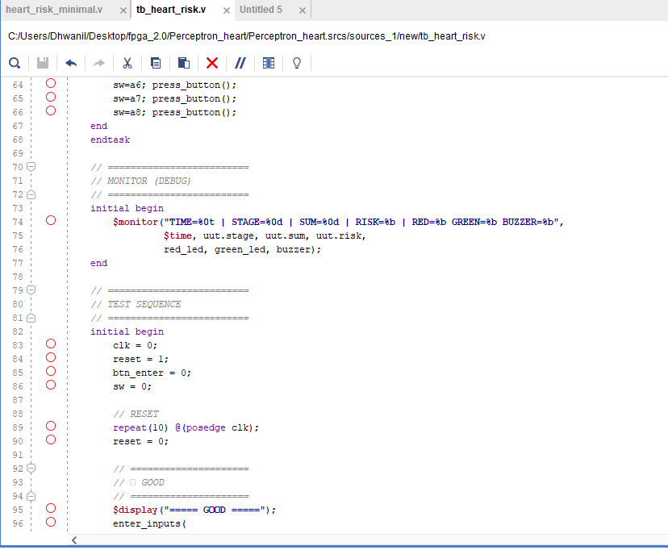
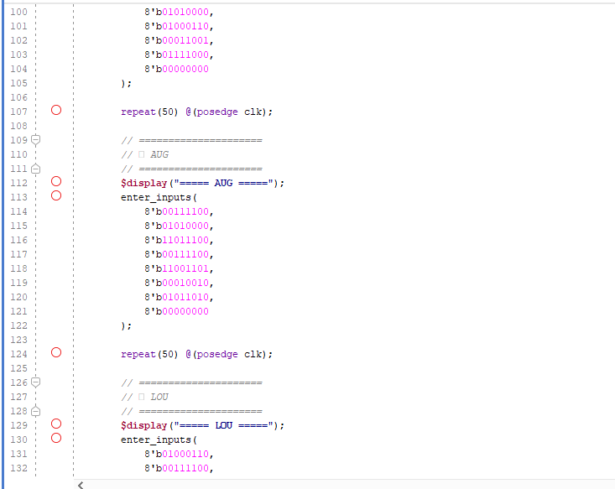
Test Bench code

Slide 18
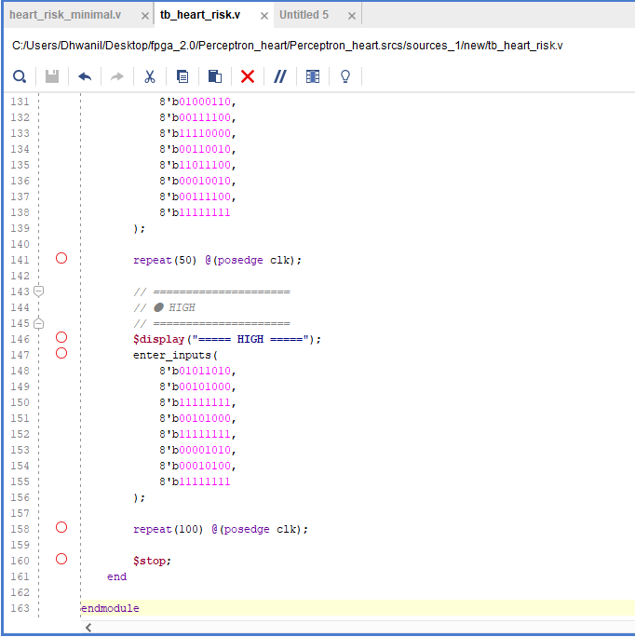
Test Bench code

Slide 19
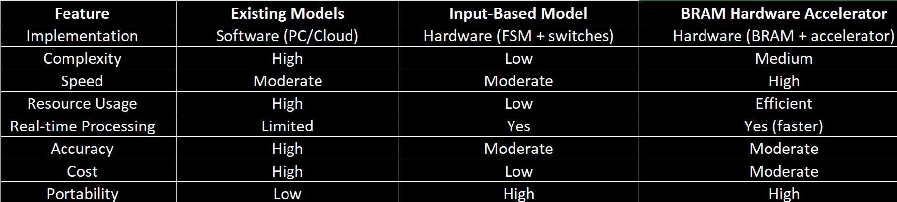
Comparison
Summary:
Input-based model → simple & low-cost
BRAM model → faster & optimized
Existing models → accurate but resource-heavy

Slide 20
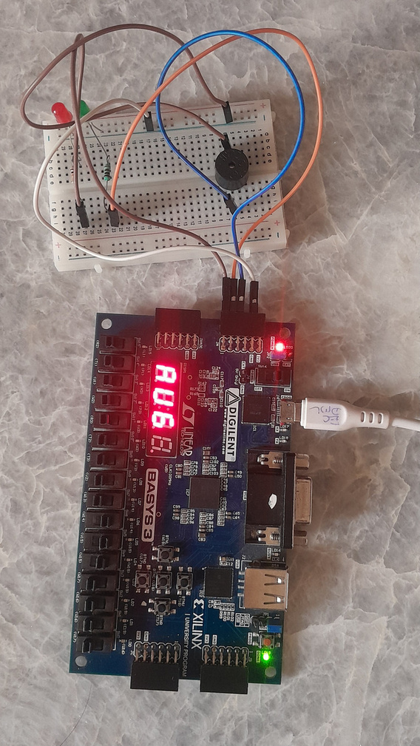
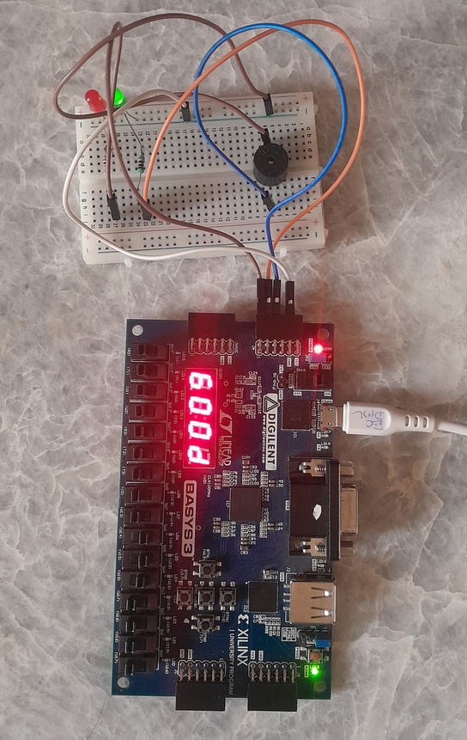
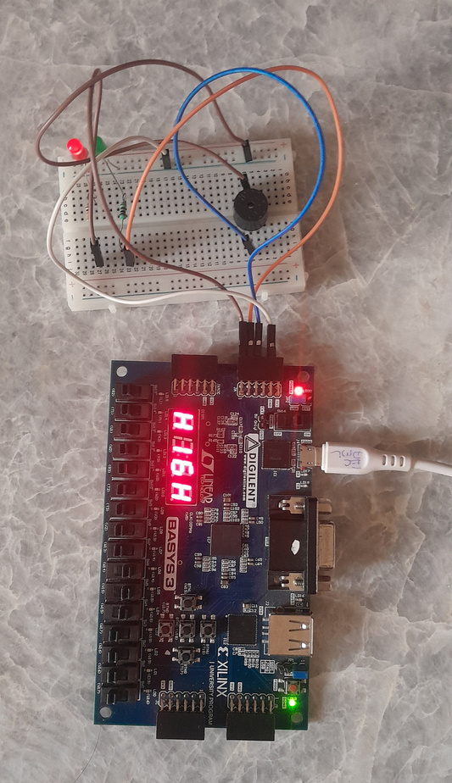
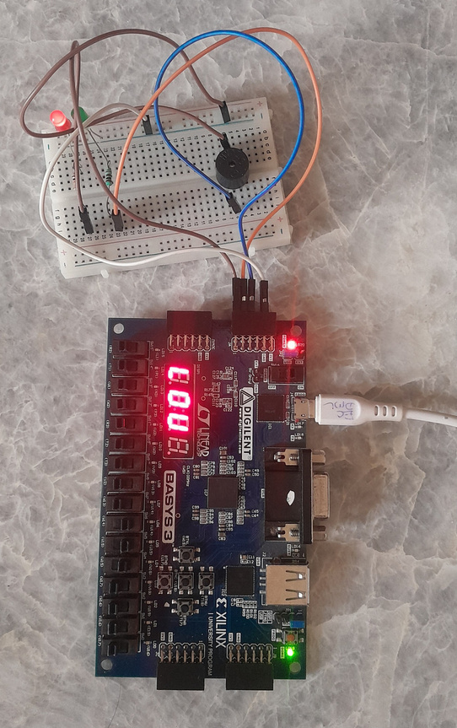
Hardware Implementation Snapshots

Slide 21
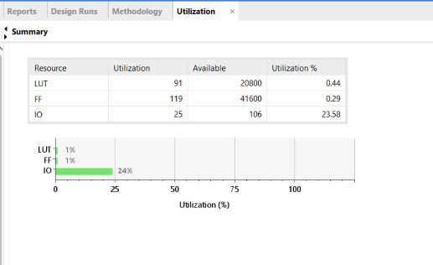
Hardware Utilization

Slide 22
Conclusion
The Heart Risk Detector using a perceptron classifier was successfully designed and implemented to predict the likelihood of heart disease based on multiple input features. The system accepts sequential user inputs through switches, processes them using trained weights and bias, and classifies the risk into different categories such as HIGH, LOW,AVERAGE, and GOOD.
The implementation demonstrates how a simple machine learning model like a perceptron can be efficiently realized in hardware using Verilog and finite state machine (FSM) design. It highlights the integration of digital design concepts with artificial intelligence for real-time decision-making.
Overall, this project provides a practical understanding of classification algorithms, hardware optimization, and embedded system design, showing that even basic models can be effectively applied to solve real-world healthcare problems.

Slide 23
Thank You

